Slide 1
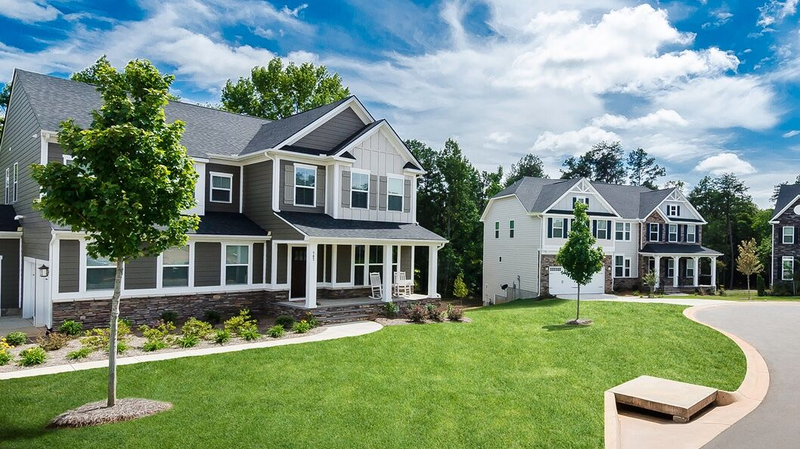
Home Prices
Thinkful Data Analytics FLEX
Capstone 2 Review
Joseph Bermudez

Slide 2
The Data
The Ames Housing dataset was compiled by Dean De Cock for use in data science education. It's an incredible alternative for data scientists looking for a modernized and expanded version of the often cited Boston Housing dataset.
Question: What are some key factors that drive home prices?
Common factors buyers look for include, number of rooms, central air, garage, and overall condition
$109,000 - $189,000

Slide 3
Central Air
Homes sold with Central Air: $186,186
Homes sold with no Central Air: $105,264
*Avg of + $81k to Sale Price

Slide 4
Rooms
Homes with 2-5 Rooms: $135,313
Homes with 6+ Rooms: $197,574
*Avg of + $62.2k to Sale Price

Slide 5
Garage vs. No Garage
Homes sold with no garage: $103,317
Homes sold with garage: $185,479
*Avg of + $82k to Sale Price

Slide 6
Overall Condition
*all homes overall condition were graded on a 1 (low)-10(high) scale at time of sale*
Overall Condition of homes sold <=“5” : $194,684
Overall Condition of homes sold >= “5”: $158,216
*Avg of + $36k to Sale Price

Slide 7
Discussion & Recommendations
Main Factors: Homes with 6+ rooms, a garage, Central Air, and/or had an overall condition of 5/10 all were the most sought after
Investment capital earmarked for investment into mortgage-backed securities should consider these factors
Homes with these factors will be the most attractive in the current market.

Slide 8
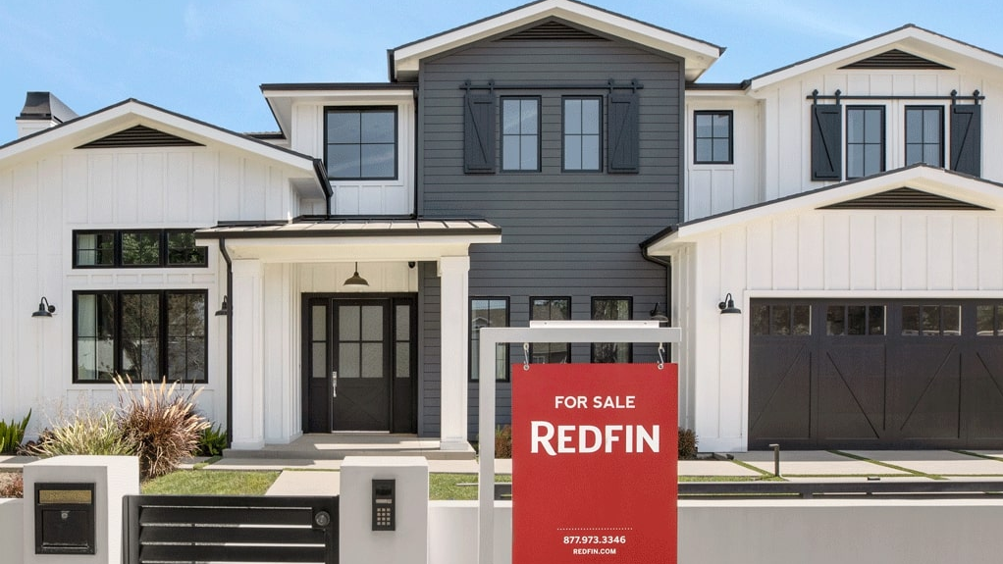
Questions?

Slide 9
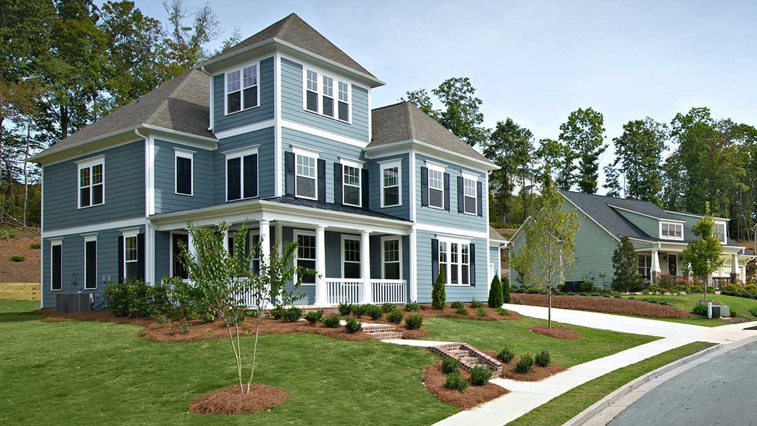
Thank you

